Slide 1

DAWSON COUNTY GOVERNMENT
Financial Status Update
^{1st.} Quarter 2023
May 4, 2023

Slide 2
Dawson County General Fund-as of 3/31/23
Main operating fund of the County Budget Benchmark= 25%
Original FY 2023 Budget $37,292,621
Current FY 2023 Budget $38,142,058
Revenue Total YTD $7,465,481 19.57% of budget
Expenditure Total YTD $7,638,510 20.03% of budget
Break-even (rev to exp) does not usually occur until
3rd quarter

Slide 3
Prior Year Comparison-General Fund

Slide 4
General Fund Revenues as of 3/31/23

Slide 5
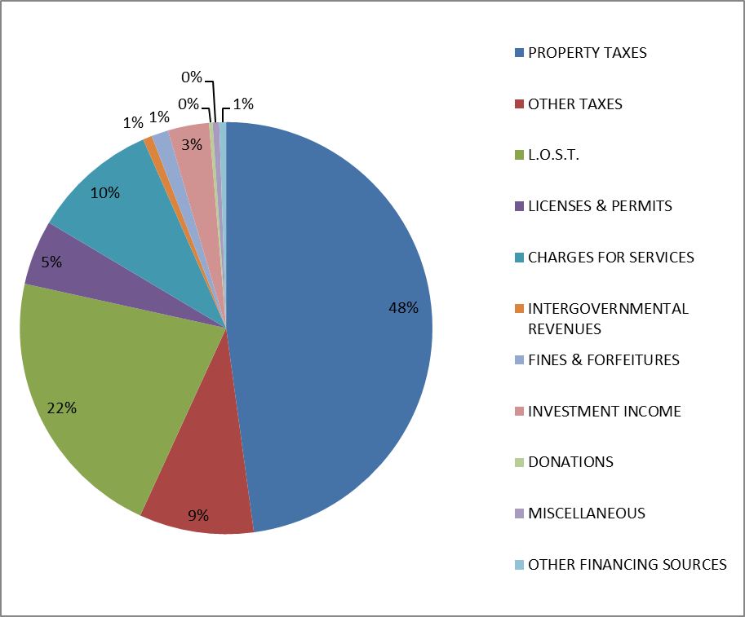
General Fund Revenues Budget for FY 23

Slide 6
L.O.S.T. (Local Option Sales Tax)
MONTH | 2023 | 2022 | % Change
January | 812,442.48 | 801,628.52 | 1.35%
February | 801,637.31 | 787,732.56 | 1.77%
March | 937,476.20 | 921,812.97 | 1.70%
YTD Total | $2,551,555.99 | $2,511,174.05 | 1.61%
NOTE: March receipt will be accounted for in April. Included in this slide for presentation purposes.
YTD change = $40,381.94

Slide 7
General Government Expenditures

Slide 8
Judicial Expenditures

Slide 9
Sheriff Expenditures

Slide 10
Public Safety Expenditures

Slide 11
Public Works Expenditures

Slide 12
Health & Welfare Expenditures

Slide 13
Recreation & Culture Expenditures

Slide 14
Housing & Development Expenditures

Slide 15
Other Financing Uses

Slide 16
TOTAL GENERAL FUND EXPENDITURES BY FUNCTION

Slide 17
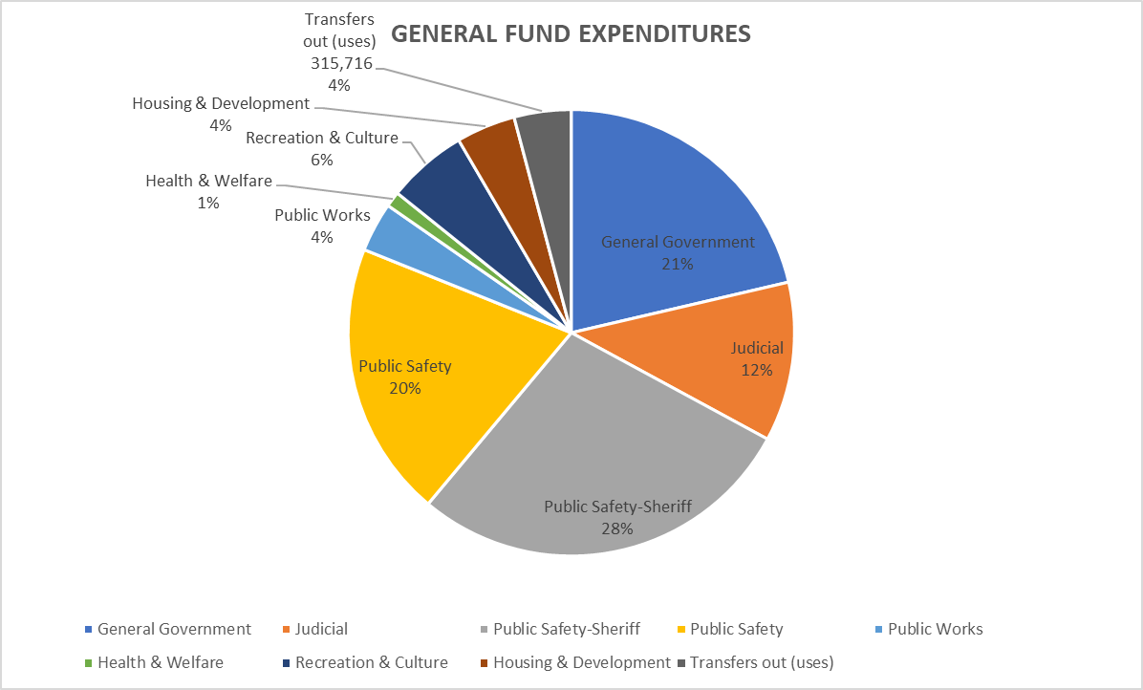

Slide 18
Investment in Employees
62 cents of every dollar spent YTD out of General Fund has been for salaries/benefits

Slide 19
Salary/Benefits- All funds
From 2019 to 2022, there was a $5.2 million (27%) increase for personnel costs

Slide 20
Significant additions to GF Budget in FY 23
$ 78,887 Addition of one SRO
$ 113,812 Addition of (2) new positions for Parks & Rec
$ 110,564 Carry over from FY 22 Safety Funds

Slide 21
FY 22 Close out
FY 22 audit field work was performed last month. Auditors are working on results and will present to the Board at a future date.
Year end budget adjustments were completed using funds already appropriated by the BOC.
It is anticipated that the General Fund will see an increase in fund balance of approximately $4 million as of 12-31-22.
3 main reasons for the increase:
-$1.3 million in expense moved from General Fund to the ARPA fund
-Revenues came in higher than anticipated
-Budgets were not fully expended due to personnel vacancies

Slide 22
Other funds

Slide 23
ARPA FUND (American Rescue Plan Act)

Slide 24
S.P.L.O.S.T. REVENUE (Special Purpose Local Option Sales Tax)
MONTH | 2023 | 2022 | % Change
January | $946,290.62 | $910,941.49 | 3.88%
February | 934,658.20 | 894,728.07 | 4.46%
March | 1,100,756.23 | 1,47,001.09 | 5.13%
YTD Total | $2,981,705.05 | $2,852,670.65
Change |  | $129,034.40 | 4.52%
monthly average for SPLOST VII is $1,069,725
March payment received in April added for presentation purposes.

Slide 25
S.P.L.O.S.T. VI YTD EXPENDITURES

Slide 26
S.P.L.O.S.T. VII
Collections began July 1, 2021
Total collections through 3/31/23 = $21,363,471.75
Total spent 1st. Qtr. $197,459.02
Total encumbered $2,531,916.39

Slide 28
Impact Fees
Impact fees were re-instated in 2018.
Over $6.6 million has been collected since that time.
Impact fees can only be used for capital improvement related to growth in the county. Not for salaries and other regular maintenance repairs and operations.
Departments designated use of these funds are: Library, Parks, Emergency Services and Roads.
Uses of Impact fees since 2018: Fire Truck $122,000, Two ambulances $746,054, Park Expansion $1,998,244 (plus $1,070,111 currently encumbered), Library $71,032.

Slide 29
Notable Purchases/Projects-1st. Qtr.
SWAT vehicle on order for Sheriff.
LMIG Projects in process by Public Works.
Planning and discussions regarding the new Emergency Operations Center are underway. Jericho Design Group has the program discussion meeting on May 8.
Communications upgrade- Federal Engineering has the design contract and RFPs opened on April 27 and are under review. Pricing should be to the Board May 18th.
Planning is ongoing for the Shoal Creek Roundabout.
IT working on server, phone and computer upgrades.
Turf fields at Rock Creek and Veterans Memorial Park- ADA and football fields are completed and the multipurpose field is in process.
Canoe put-in ramp completed.
Dawson Forest/Highway 53 roundabout and Thompson Creek Road realignment is underway. GDOT still working on updating plans for roundabout.

Slide 30

CONCLUSION
The first quarter of 2023 has been a financially successful quarter, and it is anticipated that the year will continue in a positive direction.
Thank you to all the Elected officials, Department Directors and Staff who work to make Dawson County a fiscally sound county government.
QUESTIONS????

